Slide 1
Computer Science Club
1st November 2019

Slide 2
Attendance
https://goo.gl/SGWMBB

Slide 3
While Loops
While loops will run whatever code is inside of the loop until whatever parameter is set is no longer true.
while(true) { parameter
//code here
}

Slide 4
While Loops Syntax
boolean x = true;
while(x == true) {
System.out.println(“True!!”);
x = false;
}
//this will print “True!!” once

Slide 5
While Loops Practice Problems
Use a while loop to print all the numbers until n
Use a while loop to print numbers from 10 to 2, decreasing
Write an infinite while loop

Slide 6
While Loops Advanced Problems
Use a while loop to print all characters in the alphabet
Use a while loop to print all even numbers between 1 - 100
Then, all odd numbers between 1 and 100
Use a while loop to print the sum of numbers from 1 to n
Use while loop to print a multiplication table for numbers from 1 - 12
Then, from 1 to n

Slide 7
Do While Loops
boolean x = false;
do {
System.out.println(“Hello!”);
x = false;
} while(x == true);
//this will print “Hello!” once

Slide 8
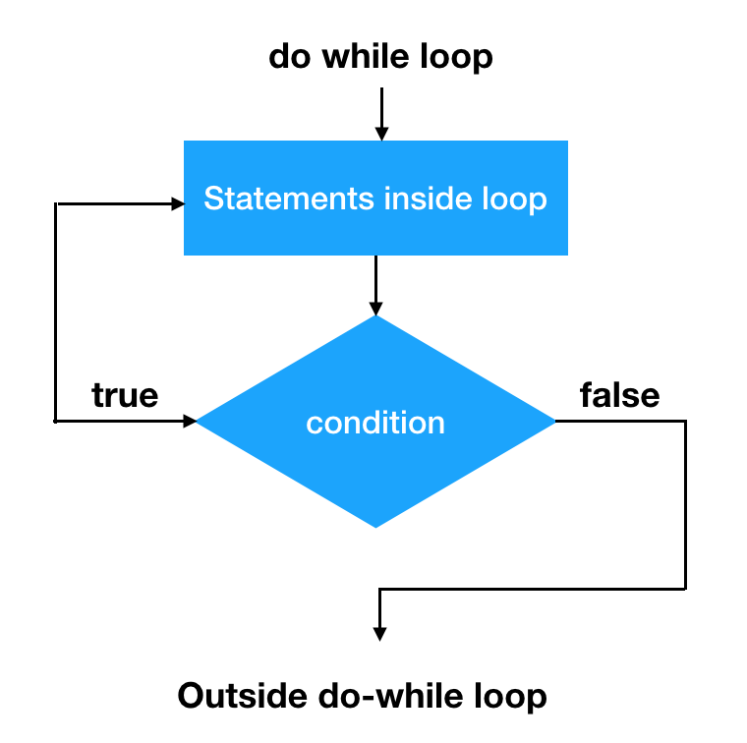
Do while loop project!
Use a do-while loop to test whether a user has entered data of the correct form and, if not, ask repeatedly until the data entered is correct.
Hint: this will require knowledge we learned previously. Can you remember?

Slide 9
Scanners
Allow user input for your programs
import java.util.Scanner;
public class App
{
public static void main( String[] args )
{
Scanner scanner = new Scanner(System.in);
}
}

Slide 10
Example of asking for input
Scanner scanner = new Scanner(System.in);
System.out.print("What is your name: ");
String userName = scanner.next();

Slide 11
Example for asking for a Number
Scanner scanner = new Scanner(System.in);
System.out.print("Enter a number: ");
int num = scanner.nextInt();

Slide 12
Scanner Practice Problems
Ask a user for their name and print their name again like “Hello Sam!”
Keep asking for using input until they enter “quit”
Investigate the .hasNextInt() method for Scanner to keep asking for user input until they enter a number
Keep asking the user for numbers until they enter “quit”. Then print the sum of all the numbers entered by the user.
If user enters 4 then 6 then 8 then quit, the output should be “Sum: 18”
Extra Challenge: Output each number as well like “4 + 6 + 8 = 18”
public static void main( String[] args )
{
Scanner scanner = new Scanner(System.in);
}

Slide 13
Thanks for coming to CS Club!
Next Meeting - 15th Nov
Please pay your dues!!!

